Slide 1
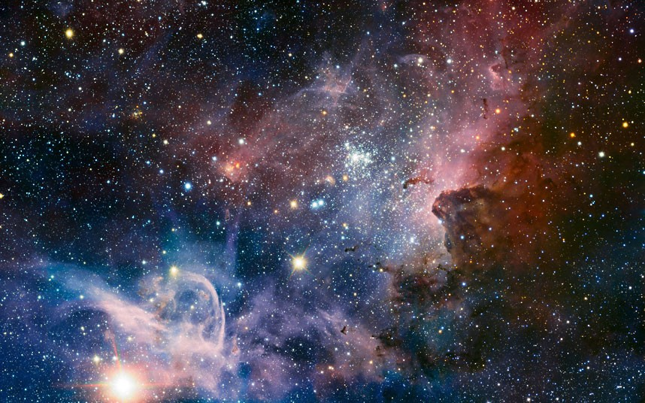


Lost in Space
Find your way home!

Slide 2
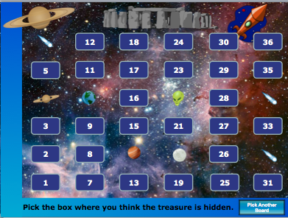
Instructions:
Divide into Teams or use individuals.
Pick a board to play. All game boards have a treasure hidden in different places. So if you use the game several times be sure to choose a different game board to prevent students from guessing where the treasure is located.
Each team or individual is asked a question. If they answer correctly, they are allowed to choose the box on the screen which they believe the treasure to be behind.
Teacher then clicks that box to reveal what is behind it.
The first to find the treasure wins. If the teacher still has questions to ask, just start the PowerPoint over and choose a different board.
Find the Earth First!
Next

Slide 3








Items to be found
1 Earth: 150 points, & ends the game.
18 planets
10 moons worth 1 point.
5 Jupiters worth 10 points
3 Saturns worth 50 points
2 aliens steal another teams points.
2 robots lose half of your team’s points.
2 supernovae resets all points to 0.
1 satellite x 3 points.
10 comets worth -5 points.
Find the Earth First!
Play

Slide 4
Find the Earth First!
To Begin Play, select a Game Board.
(Try not to play the same board
twice with the same group.)
--- Select a Board ---
1
2
3
4
5
6
7
8
9
10
End Game

Slide 5
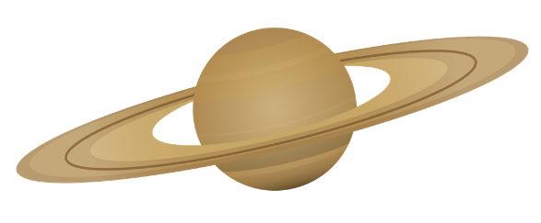
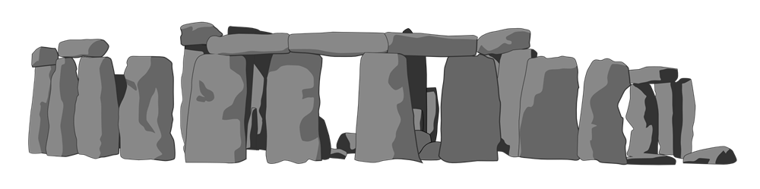


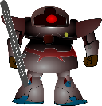
6
12
18
24
30
36
5
11
17
23
29
35
4
10
16
22
28
34
3
9
15
21
27
33
2
8
14
20
26
32
1
7
13
19
25
31
Pick the box where you think the Earth is hidden.
Pick Another Board

Slide 6

6
12
18
24
30
36
5
11
17
23
29
35
4
10
16
22
28
34
3
9
15
21
27
33
2
8
14
20
26
32
1
7
13
19
25
31
Pick the box where you think the Earth is hidden.
Pick Another Board

Slide 7
6
12
18
24
30
36
5
11
17
23
29
35
4
10
16
22
28
34
3
9
15
21
27
33
2
8
14
20
26
32
1
7
13
19
25
31
Pick the box where you think the Earth is hidden.
Pick Another Board

Slide 8
6
12
18
24
30
36
5
11
17
23
29
35
4
10
16
22
28
34
3
9
15
21
27
33
2
8
14
20
26
32
1
7
13
19
25
31
Pick the box where you think the Earth is hidden.
Pick Another Board

Slide 9
6
12
18
24
30
36
5
11
17
23
29
35
4
10
16
22
28
34
3
9
15
21
27
33
2
8
14
20
26
32
1
7
13
19
25
31
Pick the box where you think the Earth is hidden.
Pick Another Board

Slide 10
6
12
18
24
30
36
5
11
17
23
29
35
4
10
16
22
28
34
3
9
15
21
27
33
2
8
14
20
26
32
1
7
13
19
25
31
Pick the box where you think the Earth is hidden.
Pick Another Board

Slide 11
6
12
18
24
30
36
5
11
17
23
29
35
4
10
16
22
28
34
3
9
15
21
27
33
2
8
14
20
26
32
1
7
13
19
25
31
Pick the box where you think the Earth is hidden.
Pick Another Board

Slide 12
6
12
18
24
30
36
5
11
17
23
29
35
4
10
16
22
28
34
3
9
15
21
27
33
2
8
14
20
26
32
1
7
13
19
25
31
Pick the box where you think the Earth is hidden.
Pick Another Board

Slide 13
6
12
18
24
30
36
5
11
17
23
29
35
4
10
16
22
28
34
3
9
15
21
27
33
2
8
14
20
26
32
1
7
13
19
25
31
Pick the box where you think the Earth is hidden.
Pick Another Board

Slide 14
6
12
18
24
30
36
5
11
17
23
29
35
4
10
16
22
28
34
3
9
15
21
27
33
2
8
14
20
26
32
1
7
13
19
25
31
Pick the box where you think the Earth is hidden.
Pick Another Board

Slide 15
Based upon Sunken Treasure 2,
Sunken Treasure 2 Based upon Sunken Treasure
© 2010 Jeff Ertzberger
All rights reserved.
All Clipart copyright GraphicsFactory.com– All Rights Reserved. Some
images have been modified from original version.
This presentation may not be sold, or redistributed in any form without written permission of the author.
New versions modified by Chad Baldwin & Leah Pang.
For even more template games and great resources visit:
uncw.edu/EdGames
By using this game you are agreeing to our terms of use.

